Slide 1
Event Driven Collaboration
Data on the Inside vs. Data on the Outside
Ian Cooper
@ICooper

Slide 2
Who are you?
Software Developer for over 20 years
Worked mainly for ISVs
Reuters, SunGard, Misys, Huddle, Just Eat
Worked for a couple of MIS departments
DTI, Beazley
Building Event Driven solutions for over 20 years
Initially used event driven systems to scale. COM+ era
Later used event driven systems to integrate. SOA 2.0 era
Now, microservices
No Smart Guys
Only Us!

Slide 3
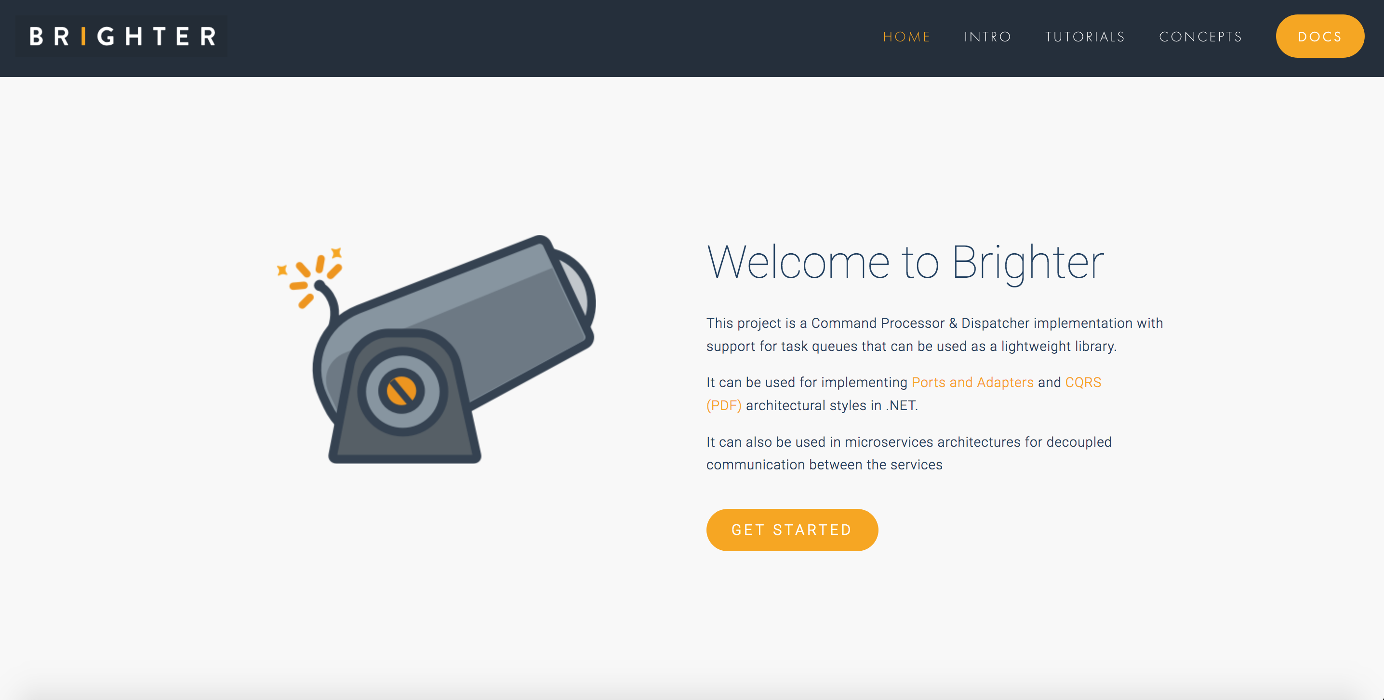

Slide 4
Agenda
Data on the Inside vs. Data on the Outside
Requests vs. Events
Pipelines & Reference Data
Correctness
Q&A

Slide 5
Data on the Inside and outside
5

Slide 6
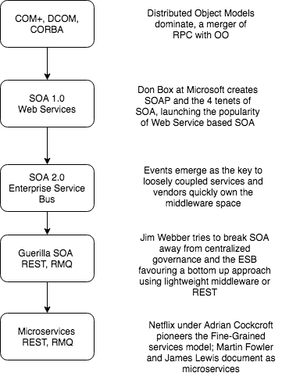
A Brief History of Microservices
The definition of Microservices, we use comes from the paper by Martin Fowler and James Lewis
Notes:
Microservices are really an iteration of SOA, with the vendor control removed, and a focus on loose coupling. Why is this important? Because there is a lot of significant guidance from SOA that is applicable to Microservices, and many operate without knowing that when a microservice document refers to concepts such as ‘business capability’ it means something specific, that has meaning to those who have an SOA background.
So when we talk about microservices there are some things we do not mean, particularly API based services or Entity based services

Slide 7
SOA
Compatibility by Policy
Direct
Bookings
API
Services are Autonomous
Boundaries are Explicit
Single Writer
Db
Share Schema not Type
Notes:
Microservices: SOA -> Guerilla SOA (Jim Webber) -> Microservices (Fred George – Programmer Anarchy)
Fowler and Lewis: Microservices -> Much more Jim Webber Guerilla SOA than Fred George “I sing the body microservices”
Services: hide code and data, expose only documented message formats for communication
Decoupling is the reason for this.
Depend upon abstractions, don’t depend on details
4 tenets of SOA, still applicable to microservices
Boundaries are explicit
Services are autonomous
Share Schema Not Type
Compatibility is based on Policy
But adds some new relevant ones like Bounded Context (a CI boundary)
A service is the ‘system of record’ for some part of our system
There is only a single writer of that data - this service
Often a service owns a bounded context, not just one entity or aggregate
Everyone else must ask the service for data, or listen to the service for data
Although we clearly own create, update, and delete it can be a little less obvious that we own Read.
Remember that we are trying to reduce coupling between services to allow independent deployment, so we don’t want to share schema out of the service. So our read is a stable contract, a view of our data. Because downstream clients may be hard to change, and we might want to restructure around new capabilities or algorithms then we need to insulate our internals from the external read data, and ensure that whilst that is long-lived it is not limiting our ability to change our internals

Slide 8
Reference Data
GET /booking/12345 HTTP 1.1
Cache-Control: max-age=30
Last-Modified: Fri 19 April 2019 09:00 GMT
Pat Helland
Compatibility by Policy
Direct
Bookings
API
Outside Data
Services are Autonomous
Immutable, stale, versioned
Boundaries are Explicit
Single Writer
Db
Booking.Created.Event
Message-Id: aa95b387-a17f-4907-a1d8-e597c322bfc6
Correlation-Id: d060cb3f-ec71-4257-b5c8-819d1a9ca6cb
{ items : [Booking {…}]}
Inside Data
Share Schema not Type
Notes:
But we must share state in order to function – if no one talks to us we are not a microservice, we are just a small piece of standalone software
This is request-oriented or event-oriented e.g. we a REST API or events
Pat Helland calls the data that we are the system of record for Data on the Inside.
Helland calls the data that flows to other applications in this way, response or message body is Data on the Outside.
Data on the Outside risks being ‘stale’ as soon as we publish it. Any further changes to the Data on the Inside will render what we just published ’stale’.
Data on the Outside must be versioned or timestamped so that we know how ’fresh’ it is, and whether other data we have is newer or older.

Slide 9
Reference Data is Highly Cacheable
GET /booking/12345 HTTP 1.1
If-Modified-Since: Fri 19 April 2019 09:00 GMT
Direct
Bookings
API
Browser
Forward
Proxy
Reverse
Proxy
Single Writer
C ache
C ache
C ache
Db
The Web scales by caching

Slide 10
The ‘Join’ Problem
15

Slide 11
Getting work done in a Monolith
API
Presentation
Direct
Bookings
Credit Card
Payments
Accounts
Housekeeping
Channel Manager
Domain
ORM
Data
Db
Notes:
In a typical monolithic application, we might divide up our system into three layers.
Presentation: The widgets, in this case our HTTP API, but might it might have been server-side rendered HTML etc.
Domain: The application and domain logic
Data: Access to our persistent storage
Let us imagine that we have a request for a direct booking on account. To service this request, we would probably call some application logic in a service/command in direct bookings (1). The application logic there would load the data we needed to complete the operation, so the account details with the credit card information 2-5), so that we could then take a credit card payment (6-7). In turn we would then save the direct booking (8) andl probably call Housekeeping and Channel Manager to update their records of the number of available rooms.

Slide 12
The ‘Join’ Problem for Microservices
Direct
Bookings
Credit Card
Payments
Accounts
Housekeeping
Channel Manager
API
API
API
API
API
Db
Db
Db
Db
Db
Notes:
Now that I have a microservices architecture, I have a problem. How do I join to the data that I need to service a request?
To take the same example, if I have a booking on account, how do we take a payment. We need the credit card information held on Account, to make the Credit Card payment, before we tell Housekeeping and Channel Management that we need to book the room out.
With the rules of microservices preventing access to the database, how can I get the data I need to service the request. I can’t just pull in the data as I used to. And even if I decided that I was willing to violate the boundaries, a distributed database transaction is never a great idea if we want to scale.

Slide 13
Requests vs. Events
20

Slide 14
Request Driven Architecture
Direct
Bookings
Credit Card
Payments
Accounts
Housekeeping
Channel Manager
API
API
API
API
API
Db
Db
Db
Db
Db
Broker
Notes:
Temporal coupling is the problem that in order for us to make a Direct Booking the Channel Manager needs to be working. If we cannot update the channels, we do not take the customer’s booking. But of course this is problematic (1) Our uptime for our Direct Bookings Service is the product of the uptime of all the services that it calls (2) The channel manager may depend on external channels that have low uptimes and if so our direct bookings service becomes only as available as the worst availability of our channels (in fact worse as it is the product).
And would the business prefer: we can take a booking but might risk over-booking because one of our channels offers a room that we have already sold, or that we don’t take any bookings because we cannot guarantee against over-booking. For most business it is arguably the former
The server must be available when you call.
if I make a phone call, and you are not there I am shit out of luck. RPC is a phone call, direct communication between two participants and can be frustrating if you get a busy tone or no one answers. (nowadays we may leave an answer phone message, or send a text, but this is messaging not RPC). We will come to that later.
Pooling of resources can help here – one of anything can fail, so you need multiple servers
To avoid the client now having to know about where a server lives, which again defeats concept of RPC, then you have to use service-discovery in your runtime, so that location is hidden to caller. Good idea anyway, even if location transparency not our goal, not to have a fixed location.
Not true of decoupled invocation i.e. messaging of course.
“... the degree to which the sending and handling of a message are connected in time. If a sender is dependent on a receiver being available when a message is sent, we have high temporal coupling... Processes whose activities are strictly ordered or whose results carry forward, leaving subsequent activities unable to start until a response to a prior request has been received, are similarly temporally coupled. “ Ian Robinson

Slide 15
Using A Proxy for Availability
We load balance the requests across multiple servers
Health Checks let us know who can we route to
Proxy
Proxy
Proxy
Proxy
Credit Card
Payments
Accounts
Housekeeping
Channel Manager
Direct
Bookings
Credit Card
Payments
Housekeeping
Channel Manager
Credit Card
Payments
Housekeeping
API
API
API
API
API
Channel Manager
The proxy can also support retry and or circuit breakers to help with availability
Db
Db
Db
Db
Db
Notes:
By using a proxy we can load balance our request across a group of servers – thus reducing our dependency on any one service being up and thus improving our availability\
If the service exports a health check then we can ensure that we only route to servers that are up, and thus able to fulfill our requests
We can also make retry and circuit breaker orthogonal concerns here, eliminating transient errors and preventing a thundering herd when it does happen

Slide 16
Config
Discovery
Monitoring
Policy
Control Plane
Data Plane
Proxy
Proxy
Proxy
Proxy
Proxy
Direct
Bookings
Credit Card
Payments
Accounts
Housekeeping
Channel Manager
Direct
Bookings
API
API
API
API
API
Credit Card
Payments
Housekeeping
Channel Manager
Direct
Bookings
Credit Card
Payments
Housekeeping
Channel Manager
Db
Db
Db
Db
Db
Notes:
If everything goes via a proxy, that proxy can be used as an interception point for centralizing services:
Configuration – we can dynamically provide configuration based on the runtime environment
Discovery – we can register new instances of services, allowing us to load balance across service instances
Monitoring – we can trace requests and provide visibility as to service health
Policy – authentication, TLS, rate limiting etc

Slide 17

Event Driven Architecture
“Messaging over a lightweight message bus such as RabbitMQ”
Fowler and Lewis
Direct
Bookings
Credit Card
Payments
Accounts
Housekeeping
Channel Manager
API
API
API
API
API
Consumer has no notion of producer, just a topic on tbe broker
Channels subscribes to a ‘topic’ on the broker
Db
Db
Db
Db
Db
Broker
Notes:
A service publishes an event to a broker – usually using a topic or similar identifier
A consumer subscribes to that topic on the broker and receives messages
The channel usually offers guaranteed at least once delivery avoiding the issue of temporal coupling

Slide 18
Event Driven Architecture
Channel provides guaranteed at least once delivery
Direct
Bookings
Credit Card
Payments
Accounts
Housekeeping
Channel Manager
API
API
API
API
API
Db
Db
Db
Db
Db
Broker
Notes:
A service publishes an event to a broker – usually using a topic or similar identifier
A consumer subscribes to that topic on the broker and receives messages
The channel usually offers guaranteed at least once delivery avoiding the issue of temporal coupling

Slide 19
Event Driven Architecture
Direct
Bookings
Credit Card
Payments
The producer, Bookings, does not care that I split Housekeeping
Channel Manager
API
API
API
Cleaning
Laundry
API
API
Db
Db
Db
Db
Db
Broker

Slide 20
Pipes, Conversations and Event Carried State Transfer
25

Slide 21

Event Driven Architecture
Direct
Bookings
Credit Card
Payments
Accounts
Housekeeping
Channel Manager
API
API
API
API
API
?
Db
Db
Db
Db
Db
Broker
Notes:
We raise a booking event and it travels down the bus before being opened by the credit card payments service
The credit card payment service reads the message, that a booking has been made, and now needs to process the payment. But how?
Does it call the Direct Bookings API to get hold of the data?
- If we do this we are back where we started, and the

Slide 22

I have a local cache of the other services data, that I can use to service requests
Credit Card
Payments
Push
Not
Pull
API
Accounts
Reference
Cache
Credit Card
Payments
API
Payments
Db
I receive a Document Message that contains the data required to process event
Payments
Db

Slide 23
Pipes and Filters
Direct Bookings
Accounts
Credit Card
Payments
API
API
API
Credit Card Payments can use the enriched information to process
We send the booking message to Account to enrich it.
Bookings Db
Accounts Db
Credit Card Db
Broker
Notes:
Pipes and Filters
One way to add the information we need to the document message is to route if via systems that can enrich it with data.
We might have two customers: guest accounts, that include the payment details in their booking, and and subscriber accounts that have already registered their payment details.
We can turn this into one ’booking made’ request by passing it through a pipeline, so that when a subscriber account booking is made, which has no payment data, we enrich the message with the missing data before passing it downstream to the credit card service. This helps us keep services from needing to make a request to the service that originates the data, by including the missing values in the message.
Pipes and Filters is choreography as there is no central controller

Slide 24
API Gateway
3:Saga sends enriched booking message
Direct Bookings
Accounts
Credit Card
Payments
API
API
API
2:Saga gets account details
Conversations
1:Saga makes a booking
Bookings Db
Accounts Db
Credit Card Db
Broker
Notes:
This is orchestration, because there is a central controller of the saga

Slide 25
Reference Data
GET /booking/12345 HTTP 1.1
Cache-Control: max-age=30
If-Modified-Since: Fri 19 April 2019 09:00 GMT
Pat Helland
Direct
Bookings
API
Outside Data
Services are Autonomous
Immutable, stale, versioned
Boundaries are Explicit
Single Writer
Db
Booking.Created.Event
Message-Id: aa95b387-a17f-4907-a1d8-e597c322bfc6
Correlation-Id: d060cb3f-ec71-4257-b5c8-819d1a9ca6cb
{ items : [Booking {…}]}
Inside Data
Share Schema not Type

Slide 26
Event:
{ [booking made: {
date:05 JUN
…
}}
Event Carried
State Transfer
Martin Fowler
Credit Card Payments
Accounts
Read Customer info
Notify Downstream Consumers
Worker
Write Payment
Details
Accounts Ref Db
CC Payments Db

Slide 27
Reference Data is Protocol Agnostic
Accounts
Credit Card
Payments
API
API
FTP
Accounts Db
ETL
Accounts
Reference Cache
Credit Card Db
ATOM
ECST

Slide 28
Types of Reference Data
Operand Data
Shared Collections
Historic Artefacts
Notes:
Three types:
Operands
When we talk to another service we communicate two things:
operator - a behavior that I want you to enact
operand - the data I want you to use to enact that
An operand has to make sense to the receiver, and so the receiver may need to publish information that can be used as operands - this is the ‘reference data’
Examples: Product Catalog
Historic Artefacts
A snapshot of our data, commonly used for reporting, analysis etc. Often rolled up.
Shared Collection
Data that all services tend to rely on such as Customers or Users
Differs from operands in that we may process dependent on it, not just use it to formulate requests to another system
We don’t want to request this data on demand, it’s too expensive, so we want a local cache of the data
We may convert the data into a more usable local form, but we don’t own the data so we need to avoid the risk of changing it. We may for example shred it into tables, or ignore data that we do not depend on.

Slide 29
Would I cache you as Request Data?
We cache Outside Data not Inside Data!
Reference Data does not know the rules!
Notes:
Would I cache you as Request Data?
We are trying to prevent you making a request. Another way to do this is to cache the results of a GET. To cache that data it has to be suitable ‘Outside Data’ – versioned and immutable, and a stable contract, not the implementation details. But it also has to be suitable for caching? How fast does it go stale? Will every call result in a different result set because of temporal concerns? In addition, note that I cache, not the other services internal data but Outside Data. A mistake here would be to replicate the other services internal data between two services as reference data. In particular, if I share internal data and need to share the rules to interpret it, then I couple that other microservice into my implementation details.

Slide 30
I have a local cache of the other services data, that I can use to service requests
Credit Card
Payments
Push
Not
Pull
API
Accounts
Reference
Cache
Credit Card
Payments
API
Payments
Db
I receive a Document Message that contains the data required to process event
Payments
Db

Slide 31

Choreography

Slide 32
Event-Oriented
Choreography
{POST: New Booking}
Direct Bookings
Accounts
Credit Card
Payments
API
API
API
Credit Card Payments can use the enriched information to process
Bookings Db
Accounts Db
Credit Card Db
We send the booking message to Account to enrich it.
Broker
Notes:
We might have two customers: guest accounts, that include the payment details in their booking, and and subscriber accounts that have already registered their payment details.
We can turn this into one ’booking made’ request by passing it through a pipeline, so that when a subscriber account booking is made, which has no payment data, we enrich the message with the missing data before passing it downstream to the credit card service. This helps us keep services from needing to make a request to the service that originates the data, by including the missing values in the message.
Pipes and Filters is choreography as there is no central controller. Remember when we talked about avoiding ‘entity services’. Often we will have a flow with a number of process steps. The message mimics this flow, passing through each process as the customer’s request is satisfied. Think of how pre-automation a customer order might have moved from one department to another
It uses events (perhaps document messages in this case) and has low temporal coupling.
Compensation is handled by raising an event that indicates an error, and assuming other services will take reversing action i.e. cancel a booking if a payment fails
There is explicitly no central control, as this adds behavioral coupling, although we can ‘wire tap’ the flow of messages to observe the flow.

Slide 33
Event-Oriented
Choreography (Errors)
{POST: New Booking}
Direct Bookings
Accounts
Credit Card
Payments
API
API
API
Which might in turn raise an event to notify the customer, using their email etc.
If we cannot take the payment, we raise an error event
We can take appropriate action like suspending the booking
Bookings Db
Accounts Db
Credit Card Db
Broker
Notes:
We might have two customers: guest accounts, that include the payment details in their booking, and and subscriber accounts that have already registered their payment details.
We can turn this into one ’booking made’ request by passing it through a pipeline, so that when a subscriber account booking is made, which has no payment data, we enrich the message with the missing data before passing it downstream to the credit card service. This helps us keep services from needing to make a request to the service that originates the data, by including the missing values in the message.
Pipes and Filters is choreography as there is no central controller. Remember when we talked about avoiding ‘entity services’. Often we will have a flow with a number of process steps. The message mimics this flow, passing through each process as the customer’s request is satisfied. Think of how pre-automation a customer order might have moved from one department to another
It uses events (perhaps document messages in this case) and has low temporal coupling.
Compensation is handled by raising an event that indicates an error, and assuming other services will take reversing action i.e. cancel a booking if a payment fails
There is explicitly no central control, as this adds behavioral coupling, although we can ‘wire tap’ the flow of messages to observe the flow.

Slide 34
Event-Oriented
Choreography (Routing Slip)
{POST: New Booking}
Direct Bookings
Accounts
Credit Card
Payments
API
API
API
Bookings Db
Accounts Db
Credit Card Db
We send the booking message to Account to enrich it.
Credit Card Payments can use the enriched information to process
Notes:
With a routing slip, we do not return to the broker, but we pass between point-ot-point queues, using a route contained in the message. Misunderstood, and explicitly and alternative to a broker based architecture like RMQ

Slide 35

Orchestration

Slide 36
Command-Oriented
Processor Manager
Db
1:Saga makes a booking
2:Saga gets account details
3:Saga sends enriched booking message
Direct Bookings
Accounts
Credit Card
Payments
API
API
API
Orchestration
Bookings Db
Accounts Db
Credit Card Db
Broker
Notes:
This is orchestration, because there is a central controller of the saga. We increase the behavioral coupling over Choreography because we use command->document and not events.
In return we get:
Increased visibility of the operation and the ability to manage
We send a command to book and we add a private reply queue and correlation id, then save the workflow.
Booking makes the booking and returns the id of our booking to us
We wake the workflow indicated by the correlation id and look up the next step
We send a command to accounts to ask for the credit card details and give it a reply queue, then save the workflow
Accounts adds account details to the booking and returns it to us
We wake the workflow indicated by the correlation id and look for the next step
We send a command to payments to pay for the room, and give it a reply queue, then save the workflow
Payments takes the payment and returns the result to us
We wake the workflow and complete it

Slide 37
Processor Manager
1:Saga cancels booking
1:Saga emails customer
1:Saga gets error response
Direct Bookings
Accounts
Credit Card
Payments
API
API
API
Compensation (Error)
Bookings Db
Accounts Db
Credit Card Db
Broker
Notes:
We also get a very explicit compensation flow i.e. When something goes wrong we can raise an exception and have it propagate to reverse the flow. Because the workflow has a request-reation flow, we know that the action has been reversed because we receive confirmations from all the microservices that we have reversed the transaction. Thus we get guarantees around reversal

Slide 38


2:We reserve the booking
Processor Manager
1:User
makes booking
3:User
checks out
4:User
Times Out
Direct Bookings
Accounts
Credit Card
Payments
API
API
API
Reservations
Bookings Db
Accounts Db
Credit Card Db
Broker
Notes:
We might decide that we don’t want to hold the booking of ever, particularly if the use has a number of manual steps to complete and the process manager is controlling that flow.
The user makes the booking, and puts it in their cart. Then they check out, and then they pay for it. We don’t want someone else to take their booking whilst they are checking out, but we don’t want them to walk away leaving us with an unsold room.
The answer is to reserve the room for a period of time, and timeout when that limit is reached, reversing the transaction

Slide 39
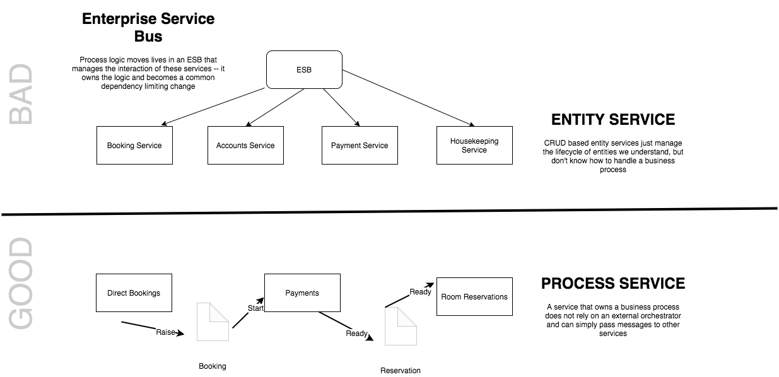
Smart Endpoints and Dumb Pipes
Notes:
“The microservice community favours an alternative approach: smart endpoints and dumb pipes. Applications built from microservices aim to be as decoupled and as cohesive as possible - they own their own domain logic and act more as filters in the classical Unix sense - receiving a request, applying logic as appropriate and producing a response.
The problem with the saga, as opposed to choreography is that it moves logic into the saga, so the endpoints become dumber, at risk of becoming entity services controlled by an orchestrator
”

Slide 40
Reference Data
GET /booking/12345 HTTP 1.1
Cache-Control: max-age=30
If-Modified-Since: Fri 19 April 2019 09:00 GMT
Pat Helland
Direct
Bookings
API
Outside Data
Services are Autonomous
Immutable, stale, versioned
Boundaries are Explicit
Single Writer
Db
Booking.Created.Event
Message-Id: aa95b387-a17f-4907-a1d8-e597c322bfc6
Correlation-Id: d060cb3f-ec71-4257-b5c8-819d1a9ca6cb
{ items : [Booking {…}]}
Inside Data
Share Schema not Type

Slide 41
Event:
{ [booking made: {
date:05 JUN
…
}}
Event Carried
State Transfer
Martin Fowler
Credit Card Payments
Accounts
Read Customer info
Notify Downstream Consumers
Worker
Write Payment
Details
Accounts Ref Db
CC Payments Db

Slide 42
Reference Data is Protocol Agnostic
Accounts
Credit Card
Payments
API
API
FTP
Accounts Db
ETL
Accounts
Reference Cache
Credit Card Db
ATOM
ECST

Slide 43
Reference Data
GET \booking\12345 HTTP 1.1
Cache-Control: max-age=30
Last-Modified: Fri 20 April 2019 09:00 GMT
Pat Helland
Direct
Bookings
API
Outside Data
Services are Autonomous
Immutable, stale, versioned
Boundaries are Explicit
Single Writer
Db
Booking.Created.Event
Message-Id: aa95b387-a17f-4907-a1d8-e597c322bfc6
Correlation-Id: d060cb3f-ec71-4257-b5c8-819d1a9ca6cb
{ items : [Booking {…}]}
Inside Data
Share Schema not Type

Slide 44
Reference Data is Highly Cacheable
GET /booking/12345 HTTP 1.1
If-Modified-Since: Fri 19 April 2019 09:00 GMT
Direct
Bookings
API
Browser
Forward
Proxy
Reverse
Proxy
Single Writer
C ache
C ache
C ache
Db
The Web scales by caching

Slide 45
Event:
{ [booking made: {
date:05 JUN
…
}}
Event Carried
State Transfer
Martin Fowler
Accounts
Credit Card Payments
Read Customer info
Notify Downstream Consumers
Worker
Write Payment
Details
Accounts Ref Db
CC Payments Db

Slide 46
Reference Data is Protocol Agnostic
Accounts
Credit Card
Payments
API
API
FTP
Accounts Db
ETL
Accounts
Reference Cache
Credit Card Db
ATOM
ECST

Slide 47
Types of Reference Data
Operand Data
Shared Collections
Historic Artefacts
Reference Data does not know the rules!
Notes:
Three types:
Operands
When we talk to another service we communicate two things:
operator - a behaviour that I want you to enact
operand - the data I want you to use to enact that
An operand has to make sense to the receiver, and so the receiver may need to publish information that can be used as operands - this is the ‘reference data’
Examples: Product Catalog
Historic Artefacts
A snapshot of our data, commonly used for reporting, analysis etc. Often rolled up.
Shared Collection
Data that all services tend to rely on such as Customers or Users
Differs from operants in that we may process dependent on it, not just use it to formulate requests to another system
We don’t want to request this data on demand, it’s too expensive, so we want a local cache of the data
We may convert the data into a more usable local form, but we don’t own the data so we need to avoid the risk of changing it. We may for example shred it into tables, or ignore data that we do not depend on.

Slide 48
Correctness
35

Slide 49
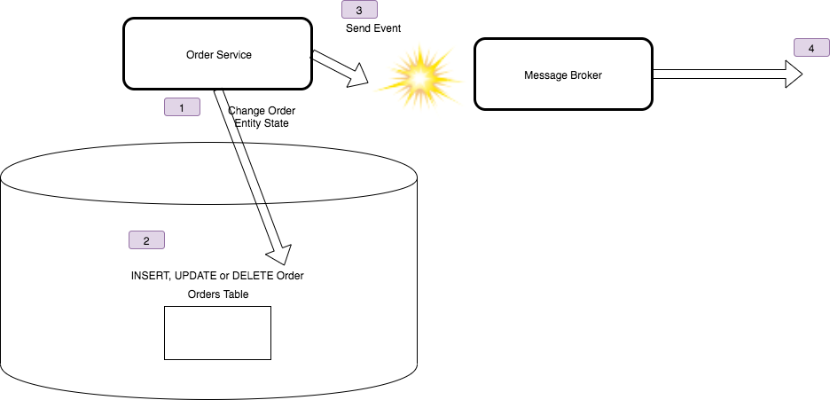
Correctness Problem

Slide 50
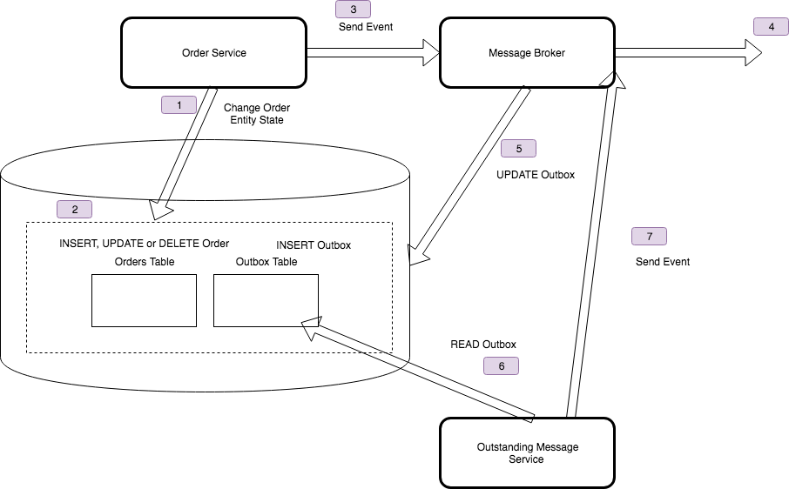
Outbox Pattern

Slide 51
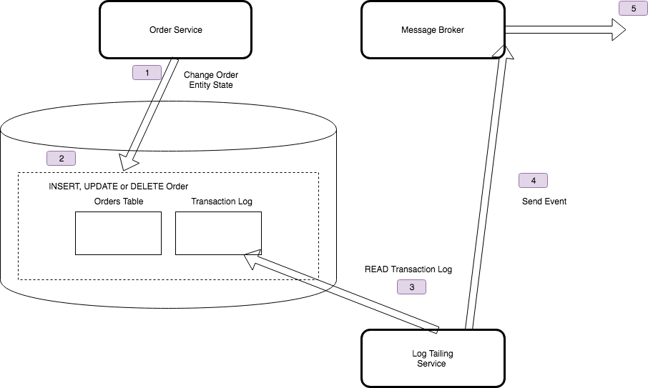
Log Tailing

Slide 52
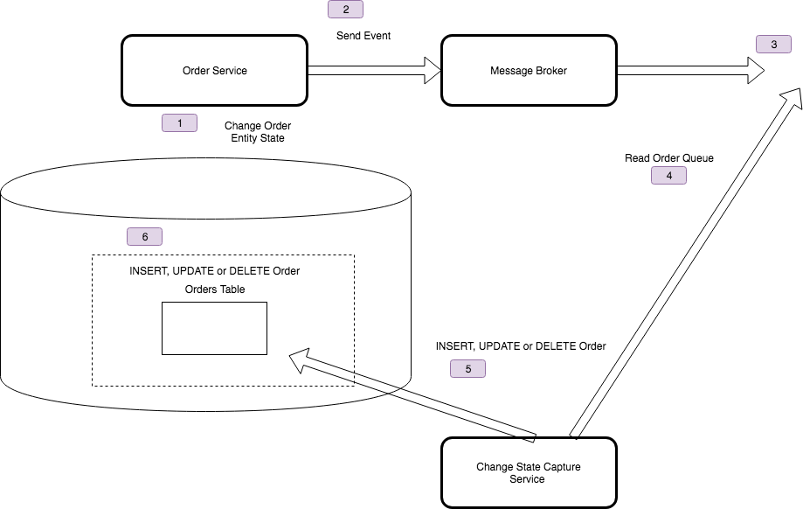
State Change Capture

Slide 53
ECST: Logs vs Queues
45

Slide 54
Shared Queue
Accounts
Credit Card
Payments
API
API
The message is deleted from the queue once actioned
Credit Card Db
Accounts Db
Accounts
Reference Cache
Outbox
Inbox
Replay must use the Outbox
De-duplication requires the Inbox
Broker
Notes:
Shared Message Queue or Shared Message Log
All distributed messaging systems store their data, replicated across nodes in a cluster, using some form of Db
In a Shared Message Queue, that storage has queue semantics, we can lock an item of the front of the queue, so as to allow other readers to skip past it, retrieve an item from the queue, and either unlock or delete the item at the end. We usually unlock for a failure to process, and delete when done. So our storage is mutable, once we have processed an item, we have changed the queue.
In a message log, the storage has append-only log semantics. We maintain an index to the next item for a consumer to read, in order, and we can manage those indexes in the distributed system to allow multiple consumers to traverse the same queue together, but we never alter the queue. So after we finish processing a message we just increment the index.
We use more storage for the log, because we are not deleting messages, but we gain the ability to reset our index and replay the messages.
With a shared queue, replay depends on an outbox or inbox
We started buy using a shared message queue and listening for downstream events
We solved ordering by using a sequential version number and resequencing when 'out-of-order'
Ordering creates a problem for consumers
We could add a sequence number to enforce ordering
[Does not work with competing consumers
We can create partitions to allow competing consumers to work
All events need to be under one topic
We may have events for a lot of entities. How do we partition?
Has limitations. How do I replay, so that I can spin up a new service (big problem in QA envirionments)?
We had an 'Outbox' but still, we needed to write code to resend and ensure other consumers discarded duplicates (i.e. have we seen this message or this version of the data for this id)
We then moved to using a shared message log (in our case GES, but Kafka is probably the default choice for many)
Arguably this is Active Service over Event Carried State Transfer, because like an ATOM-feed we pull the 'current' state by reading an immutable, read-only feed to populate our cache

Slide 55
Message Log
Accounts
Credit Card
Payments
API
API
Replay just resets the queue index for next
Credit Card Db
Accounts Db
Accounts
Reference Cache
The message remains in the queue
Outbox
Inbox
Broker
Outbox only needed if required for correctness
Inbox only needed if log does not support once-only
Notes:
Shared Message Queue or Shared Message Log
All distributed messaging systems store their data, replicated across nodes in a cluster, using some form of Db
In a Shared Message Queue, that storage has queue semantics, we can lock an item of the front of the queue, so as to allow other readers to skip past it, retrieve an item from the queue, and either unlock or delete the item at the end. We usually unlock for a failure to process, and delete when done. So our storage is mutable, once we have processed an item, we have changed the queue.
In a message log, the storage has append-only log semantics. We maintain an index to the next item for a consumer to read, in order, and we can manage those indexes in the distributed system to allow multiple consumers to traverse the same queue together, but we never alter the queue. So after we finish processing a message we just increment the index.
We use more storage for the log, because we are not deleting messages, but we gain the ability to reset our index and replay the messages.
With a shared queue, replay depends on an outbox or inbox
We started buy using a shared message queue and listening for downstream events
We solved ordering by using a sequential version number and resequencing when 'out-of-order'
Ordering creates a problem for consumers
We could add a sequence number to enforce ordering
[Does not work with competing consumers
We can create partitions to allow competing consumers to work
All events need to be under one topic
We may have events for a lot of entities. How do we partition?
Has limitations. How do I replay, so that I can spin up a new service (big problem in QA envirionments)?
We had an 'Outbox' but still, we needed to write code to resend and ensure other consumers discarded duplicates (i.e. have we seen this message or this version of the data for this id)
We then moved to using a shared message log (in our case GES, but Kafka is probably the default choice for many)
Arguably this is Active Service over Event Carried State Transfer, because like an ATOM-feed we pull the 'current' state by reading an immutable, read-only feed to populate our cache

Slide 56
Anything Else
45

Slide 57
See also: Service Consumer Patterns

Slide 58
Done!

